Slide 1
Web 2.0 vs Web 3.0

Slide 2
Introduction
Evolution of the web: From static (Web 1.0) to interactive (Web 2.0) to intelligent & decentralized (Web 3.0).
Web 2.0: User participation and social platforms.
Web 3.0: Semantic understanding,
decentralization, and AI.

Slide 3
What is Web 2.0?
Content:- Second generation of the internet.
- Focuses on user-generated content and interactivity.
- Rich interfaces using JavaScript, AJAX, and APIs.

Slide 4
Key Features of Web 2.0
Dynamic Content
- Social Networking- APIs and Mashups
- Cloud-based services
- Enhanced collaboration

Slide 5
Examples of Web 2.0
Facebook, Instagram, Twitter
- YouTube, Wikipedia
- Amazon, eBay-
Google Docs, WordPress

Slide 6
Advantages of Web
- Easy content creation and sharing
- Enhanced user collaboration
- Real-time communication

Slide 7
Limitations of Web 2.0
Content:- Centralized control of data
- Privacy and security concerns
- Spread of misinformation

Slide 8
What is Web 3.0?
Third generation of the web
- Emphasizes decentralization and semantic understanding
- Uses AI, ML, and blockchain technologies

Slide 9
Key Features of Web 3.0
Semantic Web
- Artificial Intelligence
- Decentralized networks
- Interoperability and Ubiquity
- Trustless Transactions

Slide 10
Examples of Web 3.0
:- Ethereum, Polkadot
- Decentralized apps (DApps)
- IPFS, Filecoin
- NFTs, DeFi, AI Assistants

Slide 11
Uniswap
Aave

Slide 12
Advantages of Web 3.0
User control and data ownership
- Enhanced privacy
- Smarter search and personalization
- Transparent systems

Slide 13
Challenges of Web 3.0
:Complex infrastructure
- Scalability and performance issues
- Regulatory uncertainty

Slide 14
Lack of standardization
- Limited public awareness and adoption

Slide 15
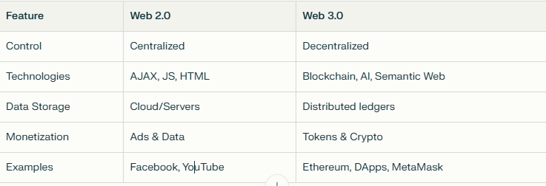
Comparison of web 2.0 and 3.0

Slide 16
Conclusion
Web 2.0 transformed how we interact online.
- Web 3.0 brings intelligence, privacy, and decentralization.
- Both are important milestones in the evolution of the internet.

